Slide 1
Beyond 508 Compliance: A Four-Point Hybrid Testing Approach
Interagency Accessibility Forum
October 12, 2022
Office of Natural Resources Revenue
Maroya Faied, Supervisory Digital Services Specialist
Lindsay Goldstein, Program Analyst
Christine Thomas, Program Analyst

Slide 2



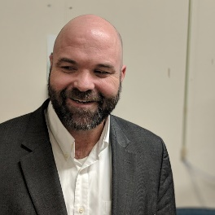
Who we are: Open Data, Design, and Development (ODDD)
Vacant
Team Manager
Maroya Faied
Program Analyst
Lindsay Goldstein
Program Analyst
Christine Thomas
Content Strategist
Vacant
Vacant
Vacant
Vacant
IDM Developer
Mojo Nichols
Supports IDM projects outside of ODDD
Digital Services Specialist
Vacant
UX Designer
Vacant
Developer
Contractor

Slide 3

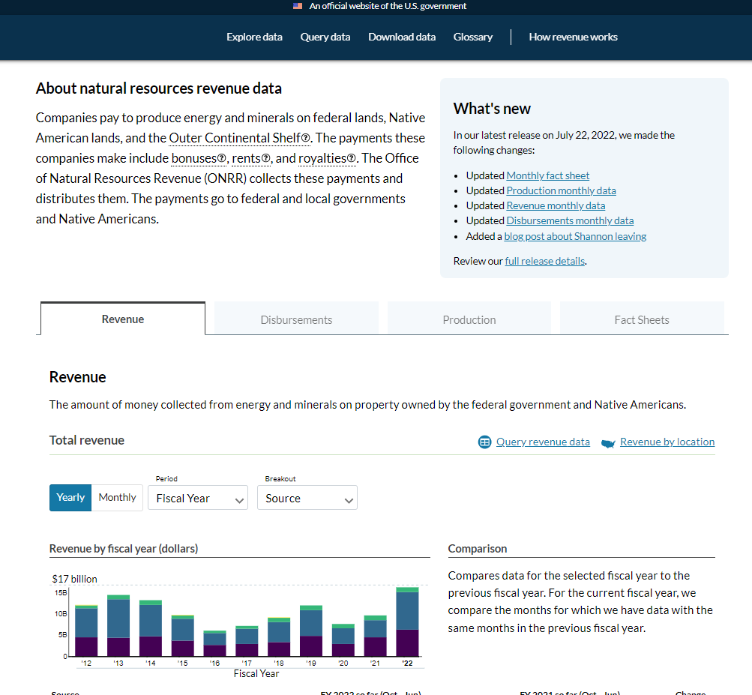
Background – ODDD beginnings
The ODDD team was created through development with 18F for the Extractives Industries Transparency Initiative (EITI) in 2014.
Through this collaboration, we developed revenuedata.doi.gov and the project was fully transitioned from 18F support to ONRR with a full innovation design team and 3 program analysts in 2018.
We have continued to proactively release natural resources revenue data and provide more analytical and visualization tools on this website.
Currently in maintenance mode.
Notes:
USA withdrew from EITI in 2017

Slide 4
Background – onrr.gov redesign
In 2020, the ODDD team was asked to manage and redesign ONRR’s other public website, onrr.gov.
This website is geared towards industry, state and tribal partners, and individual leaseholders. ONRR employees also use the website as a reference.
We did extensive user research and created user centered designs from these research findings.
Each research phase took an average of two weeks to a month. During each phase of research, we heard that needing to simplify the website and the content was important to our audience.

Slide 5
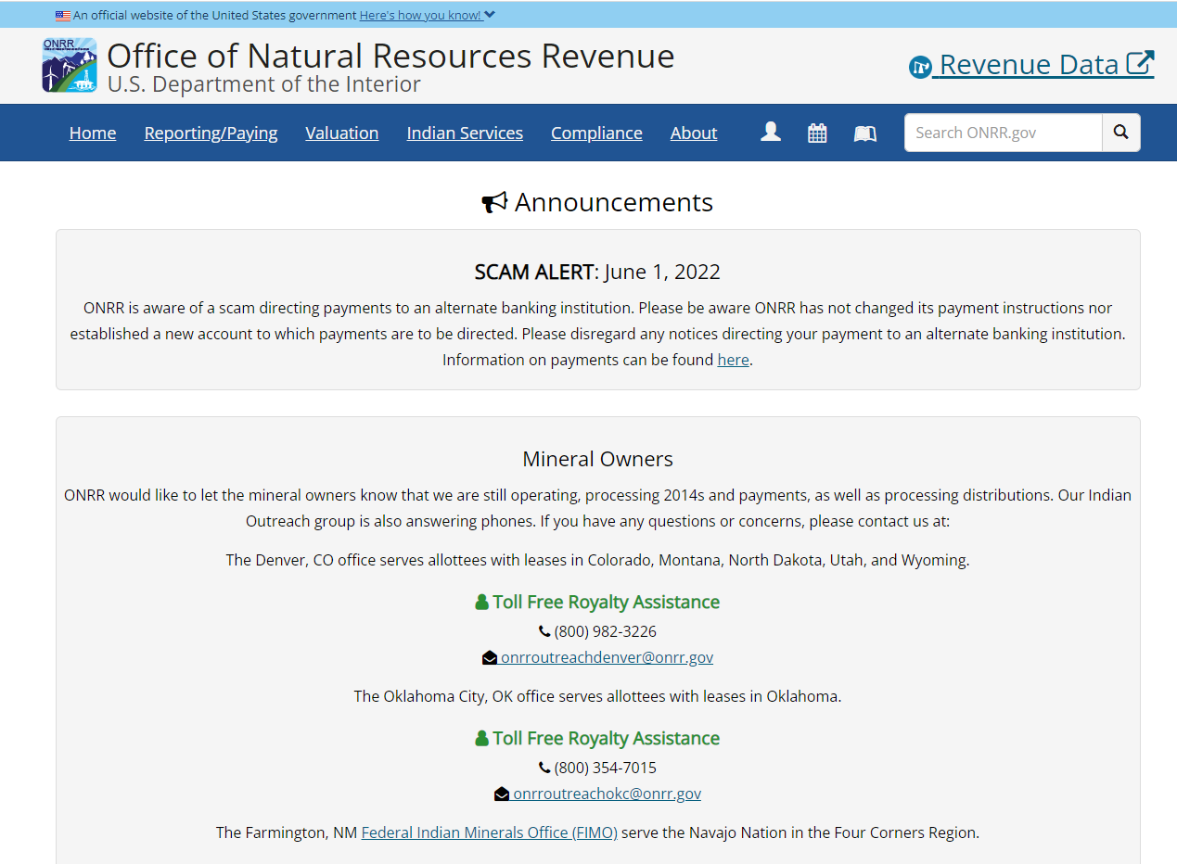
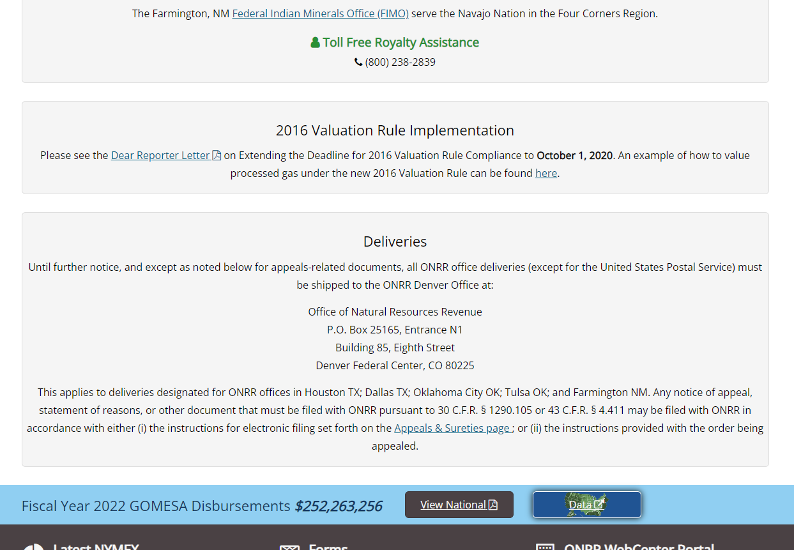
Old website homepage
Notes:
Old site- lots of scrolling to find what you need. Unclear what’s important.

Slide 6
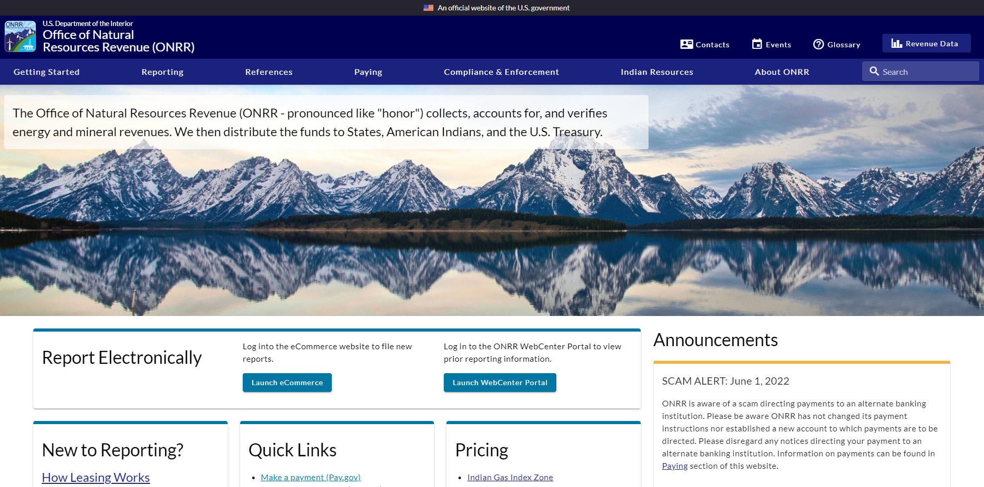
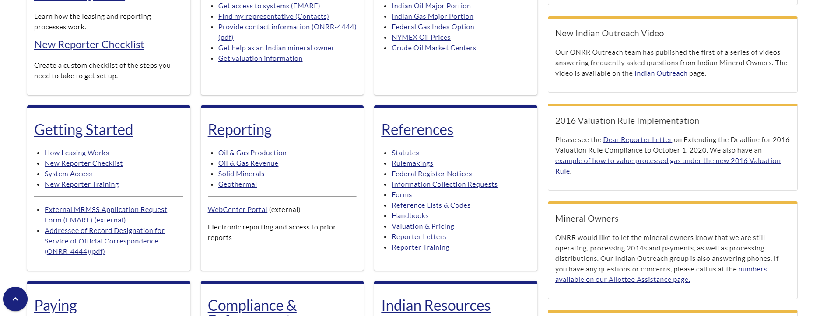
New website homepage
Notes:
New site- cards are sorted by level of use/importance. Less scrolling.
Announcements are now on the right side so they don’t take up the entire screen.
Heading levels to help with screen readers.

Slide 7
Previous accessibility work
We previously chronicled our efforts to make all documents on onrr.gov accessible.
Blog: Document accessibility: getting from 5,000 to 0
We also developed next steps for 508 compliance within ONRR.
Blog: Next steps for Section 508 compliance at the Office of Natural Resources Revenue: stakeholder interview findings
Part of these next steps was to extend accessibility beyond linked documents and to the entire website.

Slide 8
So how do you make sure a website is accessible?
Our version of four-point hybrid testing.
Original idea of four-point hybrid testing is from the Bureau of Internet Accessibility (boia.org).
Automated Lighthouse accessibility reports
Manual screen reader testing
Assistive technology user reviews the website
Iterative fixes with our developer

Slide 9
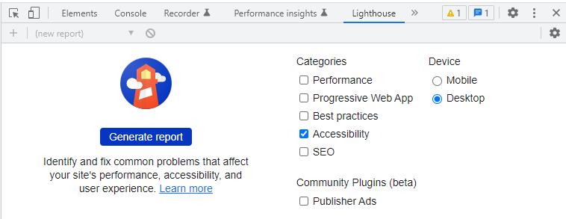
Step 1: automated Lighthouse accessibility reports
Lighthouse is located in Chrome’s developer tools.
We ran Lighthouse accessibility reports on every webpage of onrr.gov.
From the reports, we learned that some of our alt text for images and icons were not detected.
We fixed all the image alt text within the new CMS.

Slide 10
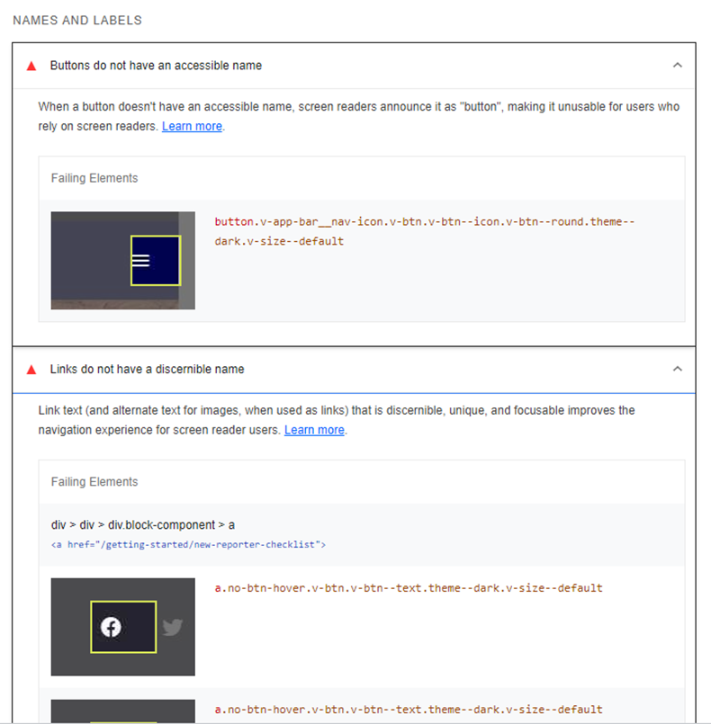
Step 1: automated Lighthouse accessibility reports (cont.)
We realized that text and labeling for icons needed to be embedded within the code - we needed our developer’s help to fix.
We made our developer GitHub issues for all the issues Lighthouse detected.
We had to prioritize because we are short-staffed with only 1 developer for both websites

Slide 11
Step 2: manual screen reader testing
While the automated Lighthouse reports give you an idea of potential accessibility issues, we wanted to test our website manually with a screen reader.
We were interested in understanding which issues truly impacted screen readers.
Our goal was to elevate those issues as high priority.
These high priority issues needed to be resolved before the website launched.

Slide 12
Step 2: manual screen reader testing (cont.)
We downloaded the NVDA screen reader and manually tested every webpage with it.
The issues we identified occurred across all webpages.
The issues we discovered were:
The screen reader was not reading the content within the drop-down menus on the top menu bar.
The screen reader was not identifying or reading the left-hand navigation menu.
The screen reader was not identifying headings, even though content was specifically formatted as headings within our CMS.

Slide 13
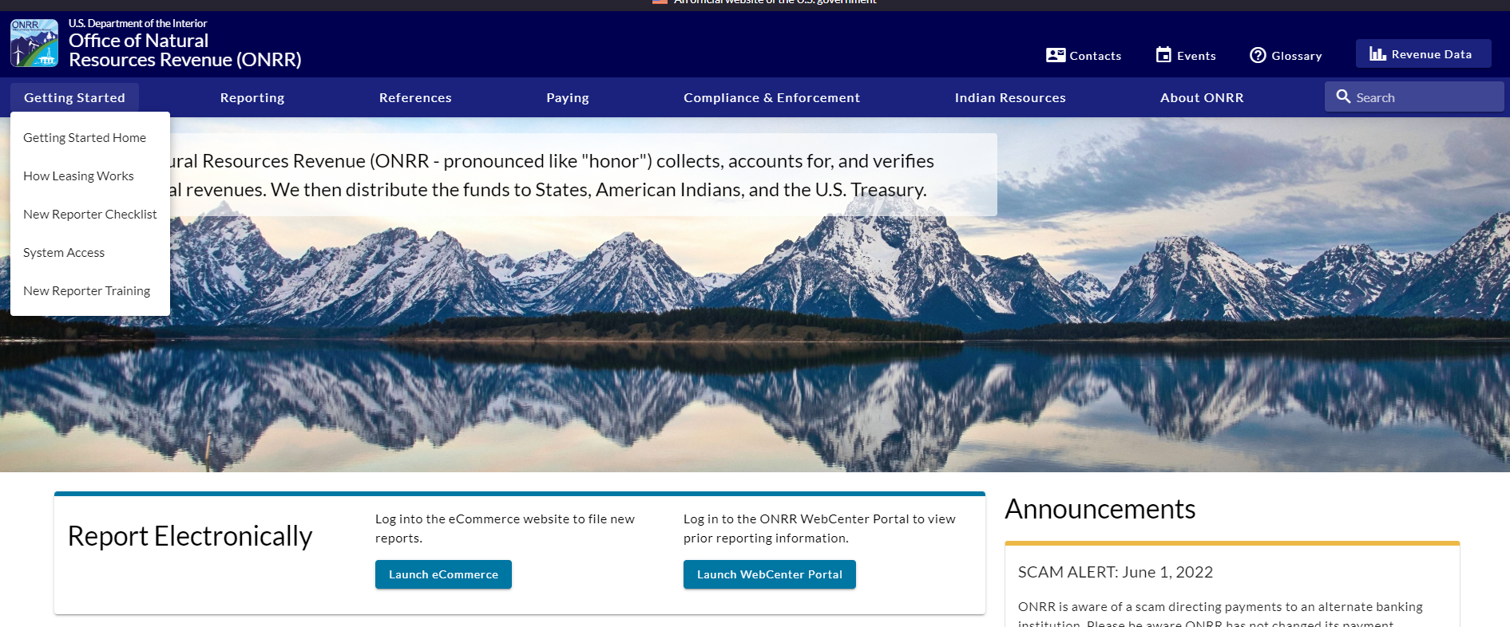
Step 2: manual screen reader testing (issue #1)
1. The screen reader was not reading the content within the drop-down menus on the top menu bar.

Slide 14
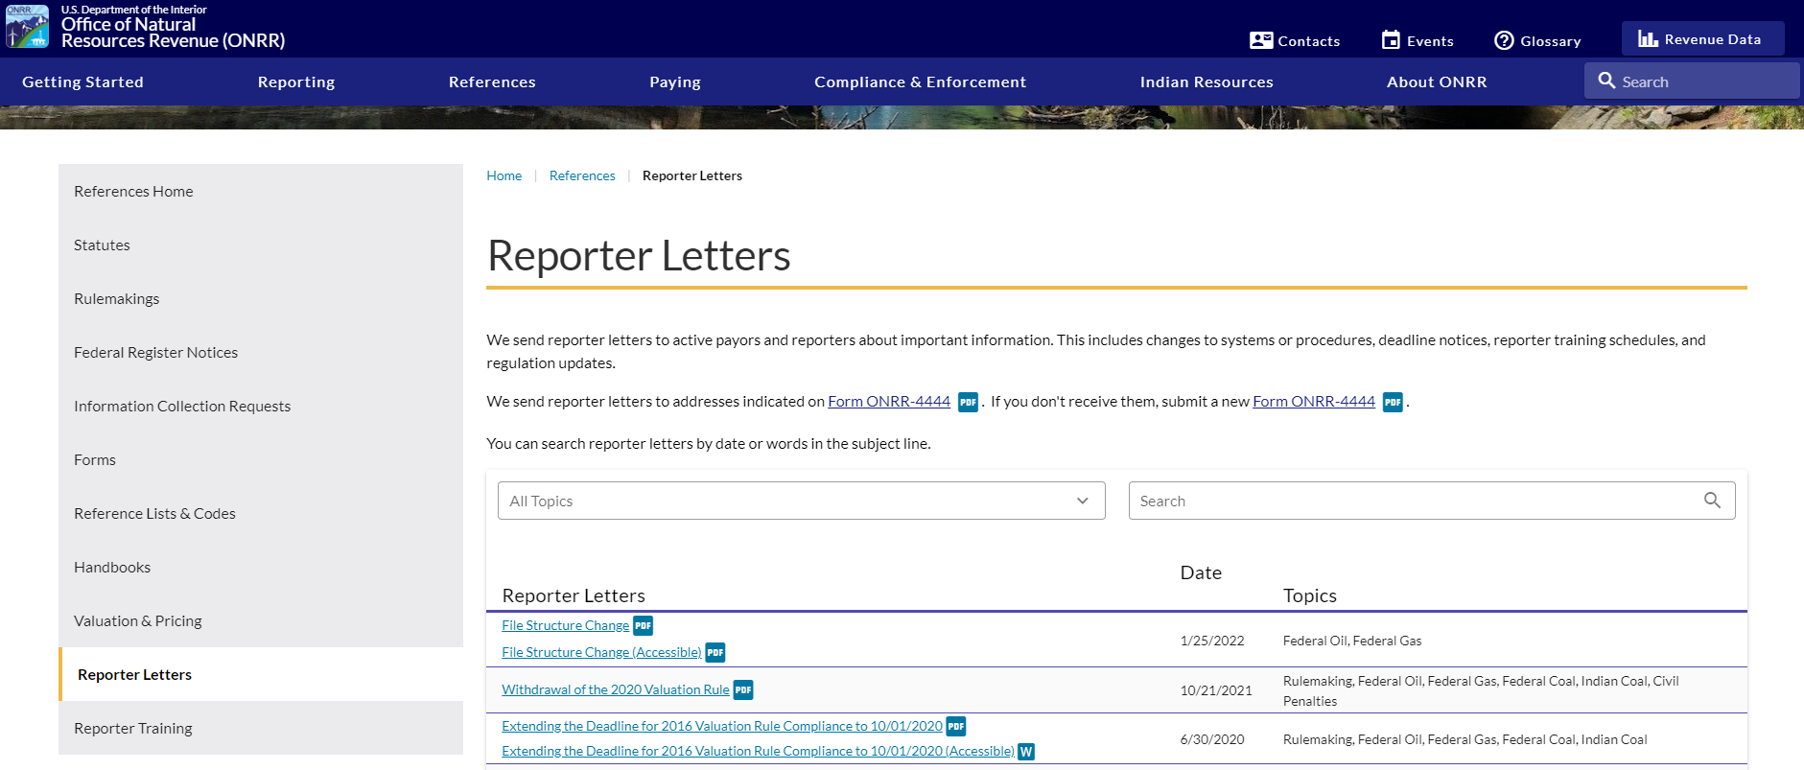
Step 2: manual screen reader testing (issue #2)
2. The screen reader was not identifying or reading the left-hand navigation menu.

Slide 15
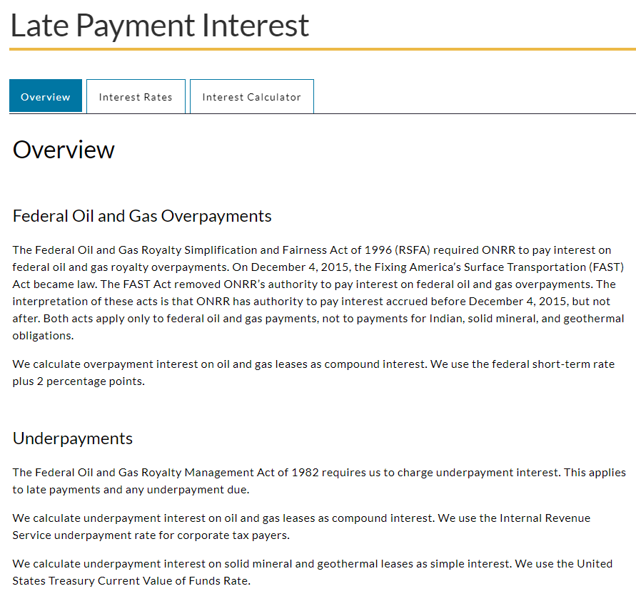
Step 2: manual screen reader testing (issue #3)
3. The screen reader was not identifying headings, even though content was specifically formatted as headings within our CMS.

Slide 16
Step 2: manual screen reader testing (decisions)
We suspected that these three issues were major flaws that needed to be addressed immediately for the new website to meet accessibility requirements.
Before elevating as high priority and creating GitHub issues for our developer, we wanted to verify our testing results with someone who uses assistive technology daily.

Slide 17
Step 3: assistive technology user reviews the website
We are lucky to have an assistive technology user who is also a subject matter expert within ONRR, Samuel Herbert.
We asked Sam if he had time to review the site with us.
We let him know about all the errors we discovered. We asked him to confirm if the issues we identified were indeed serious accessibility errors, and asked him to let us know if he found any additional errors that we missed.
We had a meeting where Sam demonstrated how he used the screen reader.
Sam confirmed that the three issues we found with the screen reader needed to be fixed before we could say our new site was accessible.
Without these fixes, he could not navigate the website easily.
Once these errors were fixed, our site could accurately be classified as accessible.

Slide 18
Step 3: assistive technology user reviews the website (developer fixes)
We elevated these three issues as high priority, and our developer did an amazing job at fixing these errors within the back-end coding.
We did a second round of testing and confirmed that:
1. you could now use “Alt+Down Arrow” to access the drop-down menus,
2. the screen reader was accurately identifying and reading the left-hand navigation menu, and
3. the screen reader was identifying the headings and you can use the “H” key to navigate through the headings.
After this second round of testing, we let Sam know these issues were fixed.
We set up another meeting with him to confirm.
Sam tested the site again and was happy with its usability.
He said we could consider the site accessible, since he was able to navigate the website easily using the screen reader.

Slide 19
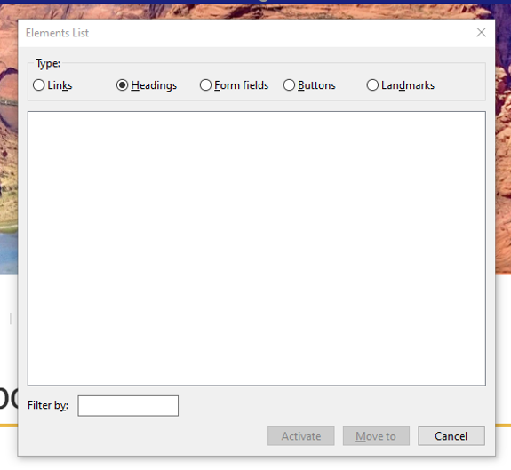
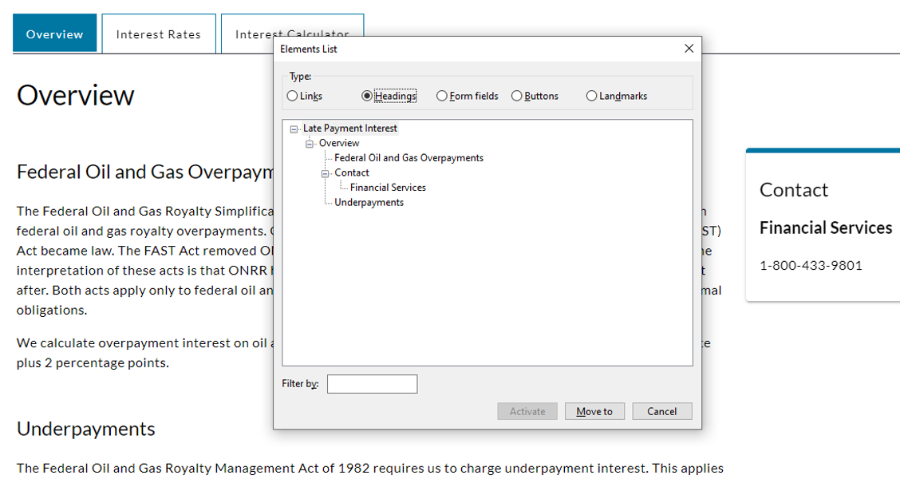
Step 3: assistive technology user reviews the website (results)
Before and after of NVDA’s elements list, showing that the headings are now properly coded.

Slide 20
Step 4: iterative fixes with our developer
Clear communication and iteration with our developer was essential in this project. In every step outlined above, we included our developer. We presented our findings to him and outlined our concerns. He helped us prioritize which issues should be fixed before launch by detailing the level of difficulty each fix was for him.
When we believed an issue was high priority and need resolving before launch, we demonstrated the issue on the screen reader for him. Our developer even took it upon himself to download a screen reader. He did his own testing before releasing the changes to us.
Making sure everyone understood the accessibility errors helped ensure that the appropriate errors got resolved before launch. Also, promoting a culture where every employee values accessibility helps projects like this get completed in a timely manner.

Slide 21
Step 4: iterative fixes with our developer (cont.)
There are still minor issues indicated by Lighthouse that we need to fix, but the major navigation and alt text issues are resolved.
We know that we are not done!
Now that the site is live, our developer will have time to tackle the minor issues in our product backlog.
Accessibility is an ongoing process for us.

Slide 22
Next steps
Everyone on our team would have loved for all accessibility issues to be resolved before launch. That was our goal. Because we are short-staffed with only one developer, we had to refocus and reprioritize our goals.
While the site is considered accessible in its current state, we are not done with accessibility!
In addition to resolving the minor accessibility errors in our product backlog, we plan to regularly check our site for accessibility issues.
Ensuring that our websites are accessible is an ongoing and iterative process.
We are proud of the steps we take to integrate accessibility into our work culture, and we are continuously learning how to improve.

Slide 23
Thank you! Questions?
Email: ONRRWeb@onrr.gob
Blog: https://blog-nrrd.doi.gov/
GitHub: https://github.com/ONRR/
Twitter: @DOIONRR
Facebook: https://www.facebook.com/DOIONRR/

